Slide 1
TCP Flow Control
1/7

Slide 2
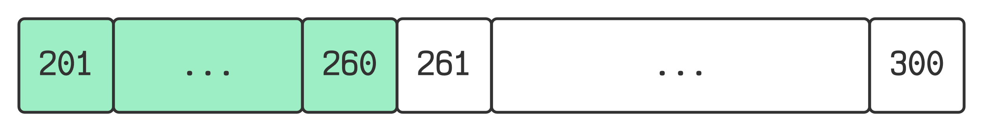
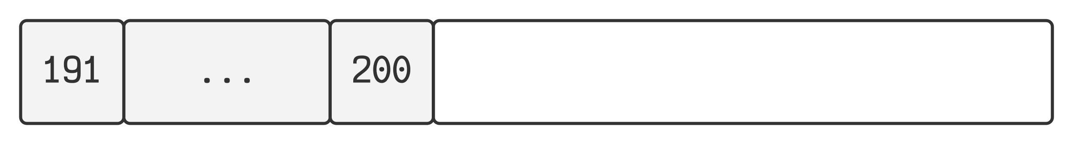
Send Window
Receive Window
Windows
→ Closes
Opens →
Buffer for unacknowledged segments and segments ready to be sent.
Unacknowledged Segments
Segments that can be sent
→ Closes
Opens →
Buffer for acknowledged (but unconsumed) segments.
Acknowledged Segments
Empty Space
2/7

Slide 3
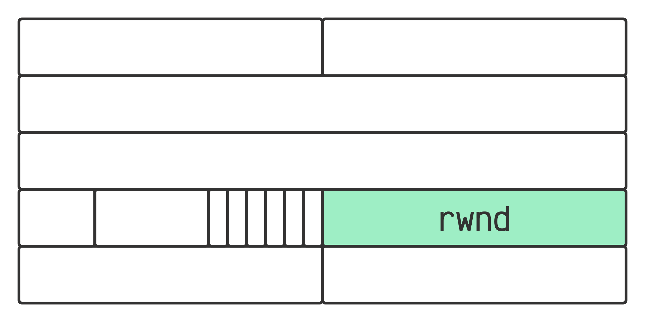
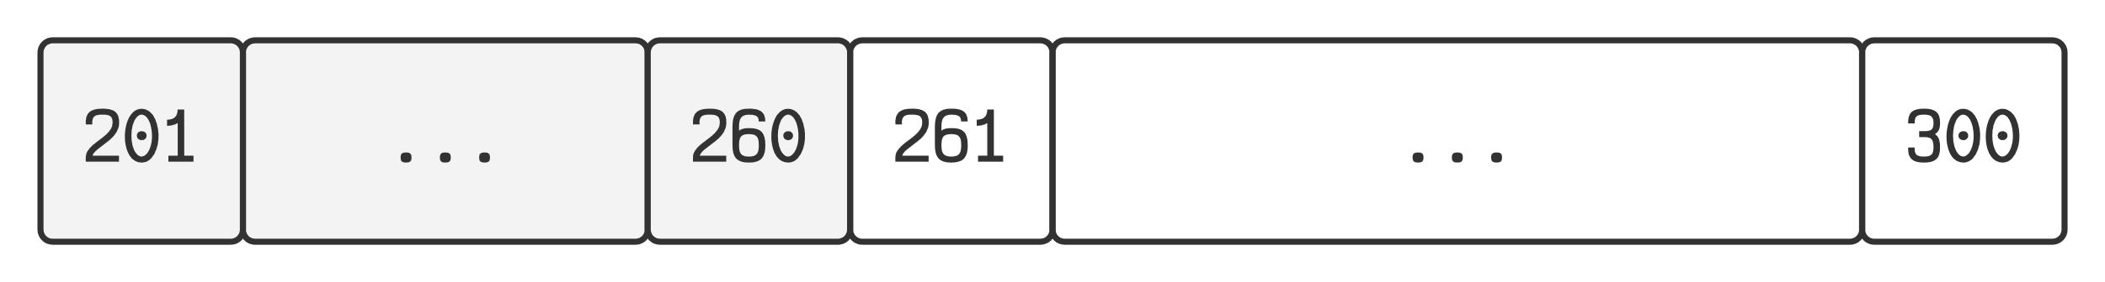
rwnd
Field in acknowledgement header
→ Closes
Opens →
rwnd
>
Send Window Size
3/7

Slide 4
rwnd
Field in acknowledgement header
→ Closes
rwnd
<
Send Window Size
4/7

Slide 5
rwnd
Field in acknowledgement header
→ Closes
Shrink ←
rwnd
<
Send Window Size
New ACK No. + New rwnd
≥
Last ACK No. + Last rwnd
5/7

Slide 6
Optimal Window Size
Problems:
Too large → Poor memory utilization
Too small → Buffer is frequently full
Depends on:
Bandwidth of link
Round trip time
IBM Netezza Replication Services, Version 1.6:
Optimal Size = (Size of the Link in MB/s) * (Round Trip Delay in Seconds)
Reference
6/7

Slide 7
Thank You
7/7

